Slide 1
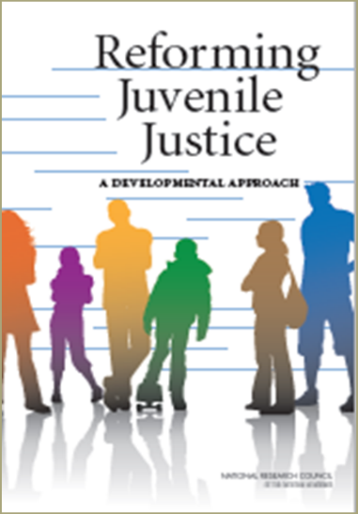
Reforming Juvenile Justice:
A Developmental Perspective
Putting principles into practice
February 2016

Slide 2
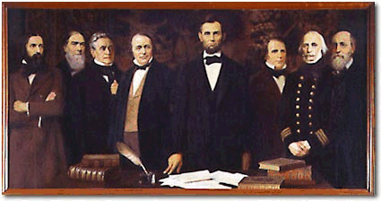
National Academy of Sciences
History
Purpose
Value added
Written reports based on evidence and rigorous analysis

Slide 3

Committee on Assessing
Juvenile Justice Reform
To assess the implications of advances in behavioral and neuroscience research for the field of juvenile justice and the implications of such knowledge for juvenile justice reform.

Slide 4
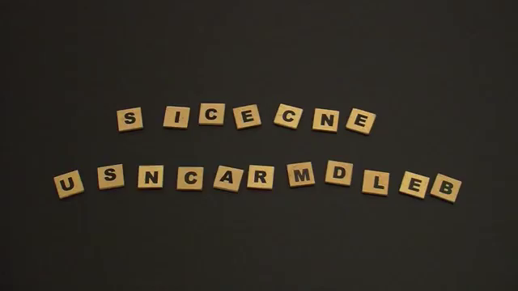
Overview of the Committee Findings

Slide 5
A Practitioner’s Perspective
Report provides a firm foundation
Overarching agenda for juvenile justice reform
Details in implementation
  Measures of success
  Measures of results
Emerging evidence about effective interventions and practices
Maintaining fidelity of reform
Investing in education of our current and future workforce

Slide 6
Polling
My community has read the report and implemented all of its recommendations.
My community agrees with the recommendations in the report.
I’m interested in learning more about the report and how it can improve how we serve youth in our community.

Slide 7

Reforming Juvenile Justice: A Developmental Perspective
Emerging consensus regarding science of adolescent development and its implications for design and operation of juvenile justice system
Recommendations
  Commitment to reform by State, Local, and Tribal Governments
  Strong Supporting Role for OJJDP
  Research Agenda on Adolescent Development, Delinquency Prevention and Juvenile Justice
  Data Improvement
Notes:
Emerging consensus among experts regarding implications for JJ policy and practice
Aim to consolidate knowledge and establish a platform for moving forward not an action plan but a basis for action plan
Turn the ball over the states to learn from the vanguard states and build the necessary political commitment and consensus
Strengthen OJJDP to be able to facilitate and support change
Sets the stage for 2nd report. How can OJJDP position itself to do this
Internal change to organize itself to become a change agent

Slide 8



The Science

Slide 9
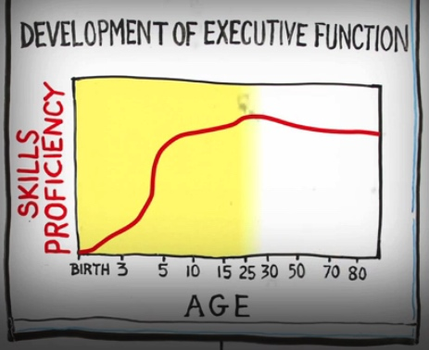
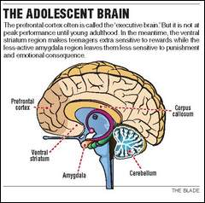
The Science
Adolescents differ from adults and/or children in three important ways:
  lack mature capacity for self-regulation in emotionally charged contexts
  have a heightened sensitivity to proximal external influences such as peer pressure and immediate incentives
  show less ability to make judgments and decisions that require future orientation.

Slide 10
Executive Function Development
Working Memory | Inhibitory Control | Cognitive Flexibility
Adult: Can remember multiple tasks, rules and strategies that may vary by situation. | Adult: Consistent self control, situationally appropriate responses. | Adult: Able to revise actions and plans in response to changing circumstances.
5-16 Years: Develops ability to search varying locations, remember where something was found, then explore other locations. | 10-18 Years: Continues to develop self-control, such as switching attention from central focus (riding a bike) to peripheral stimuli (signs vs. houses). | 13-18 Years: Continued improvement in accuracy when switching focus and adapting to changing rules.
3 Years: Can hold in mind two rules at once (e.g., red goes here, blue goes there) and action on the basis of the rules. | 4-5 Years: Reductions in perseveration (following a rule after the rule has changed), can delay eating a treat. | 2-5 Years: Succeeds at shifting actions according to changing rules (taking off shoes at home, puts on boots for rain).
9 Months: Can execute simple means-to-ends tasks and two-step plans; also able to integrate looking in one place and acting. | 8-10 Months: Begins to maintain focus despite distractions during brief delays. | 9-11 Months: Develops ability to seek alternative methods to retrieve objects beyond directly reaching for things in view.
Source: Center on the Developing Child at Harvard University (2011). Building the Brain’s “Air Traffic Control” System: How Early Experiences Shape the Development of Executive Function: Working Paper No.11. http://www.developing child.harvard.edu

Slide 11
Polling
I am aware of the science of adolescent development and try to integrate it in the work that I do with youth.
I have attended specific training on the science of adolescent development and use what I’ve learned in the work I do with youth.
All of the programs that I/we use are evidence-based and are developmentally appropriate for adolescents.
It’s better to form relationships with youth than to worry too much about the science.

Slide 12
Major Conclusions from the Research
Being held accountable for wrongdoing and accepting responsibility in a process perceived as fair promotes healthy moral development and legal socialization.
Conversely, being held accountable and punished in a process perceived as unfair can reinforce social disaffection and antisocial behavior
Policies and programs that are predominantly punitive neither foster pro-social development nor reduce recidivism
No convincing evidence that confinement of juvenile offenders beyond a minimum amount required to provide intense services reduces likelihood of subsequent offending
Pattern of racial disparities is likely to contribute to perceptions of unfairness and impede efforts to engage minority youth

Slide 13
Polling
My jurisdiction continues to be pretty punitive and to rely on confinement of juvenile offenders.
My jurisdiction has reduced the number of juvenile offenders in confinement in state facilities.
My jurisdiction has reduced the number of juvenile offenders in confinement in state and local facilities.
My jurisdiction has reduced the number of juvenile offenders in confinement in state and local facilities AND has increased its investment in community/neighborhood-based programs and services.

Slide 14
What is a Developmental Approach in Juvenile Justice?
A developmental approach to juvenile justice recognizes that illegal acts committed by adolescents occur at a time of life when individuals are more likely to exercise poor judgment, take risks, and pursue thrills and excitement. A juvenile justice system centered on a developmental approach will respond to offending behavior by providing treatment and services that:
Have youth focus on repairing the social injury or damage, understand how the behavior has affected other people, and take responsibility for their action.
Are a diverse array of activities, supports, and opportunities for normal growth (emotional, physical, intellectual),
Are delivered in environments that are appropriate to the ages and stages of the youth involved, and are conducive to healthy development.

Slide 15

Guiding Principles for
Juvenile Justice Reform
ACCOUNTABILITY
PREVENTING
REOFFENDING
FAIRNESS

Slide 16
Polling-Yes/No
My jurisdiction uses restitution and community service.
My jurisdiction uses restorative justice practices.
My jurisdiction uses confinement for only a few juvenile offenders.
My jurisdiction uses a risk/need assessment instrument and matches youth with specialized treatment and targets more intensive treatment for high risk youth.
My jurisdiction treats all youth the same.

Slide 17
Hallmarks
The Hallmarks demonstrate how the developmental approach can guide juvenile justice reform. The report outlines how these hallmarks of a developmental approach should be incorporated into policies and practices to achieve the goals of the juvenile justice system.
Accountability without Criminalization
Alternatives to Justice System Involvement
Individualized Response Based on Assessment of Needs and Risks
Confinement Only When Necessary for Public Safety
A Genuine Commitment to Fairness
Sensitivity to Disparate Treatment
Family Engagement
Notes:
#1 and #2 polls

Slide 18
Family Engagement
Include impacted families and young people among traditional stakeholder groups
Improve policies and practices that impact how agencies work with families
Resources for families
Receive and address family concerns and issues
Moving from inclusion to engagement to partnership

Slide 19

More Effective Interventions
Cognitive-behavioral approaches
Functional family therapy
Multisystemic therapy
Multidimensional treatment foster care
Aggression replacement therapy

Slide 20
Federal Funding Sources

Slide 21
Challenges
Building a consensus/agenda for reform
Implementing reform and measuring success
Sustaining reform
Reform as a journey
Notes:
#3 Poll

Slide 22

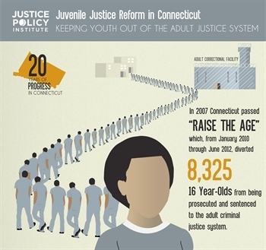
Juvenile Justice Reform
What’s next?
Reclaiming
Futures
JDAI
Justice
Reinvestment

Slide 23
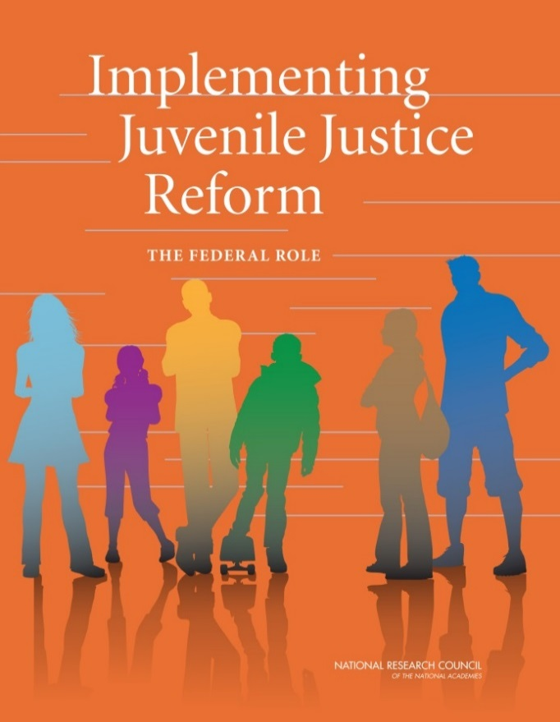

Thank you!
For more information:
claj@nas.edu
For copies of report:
http://sites.nationalacademies.org/DBASSE/CLAJ/Implementing_Juvenile_Justice_Reform/index.htm
Catalog of Federal Funding Sources for Youth in Juvenile Justice:
http://sites.nationalacademies.org/DBASSE/CLAJ/DBASSE_088937

